Slide 1
End-Of-Semester Presentation:
Bill Splitter
Team 2: Will Trimble, Glenn Todd, Ryan Yocum, Joe Wesnofske
Notes:
Joe

Slide 2
System Concept Statement
Marketed toward college students
Users can scan receipt
Cost broken down fairly
Can assign item's cost to specific person
Will help with splitting and prevent paying unfair amounts
Prevent errors in splitting bills
Once finished, can send individual requests to pay back
Integrated with multiple apps (Venmo, Cash App, PayPal)
Will create a better user experience by being simple to use and having a sense of fairness
Notes:
Joe

Slide 3
Interactive Design Requirements
Bill Splitter
Bill Splitting
Receipt Input
Scan Receipt
Manual Input
Cost Assignment
Groups
Long-Term
One-Time
Bill Payer
Payment
Payment Methods
Online Service
Credit Card
Cash
Notes:
Joe

Slide 4
Design Evolution

Slide 5
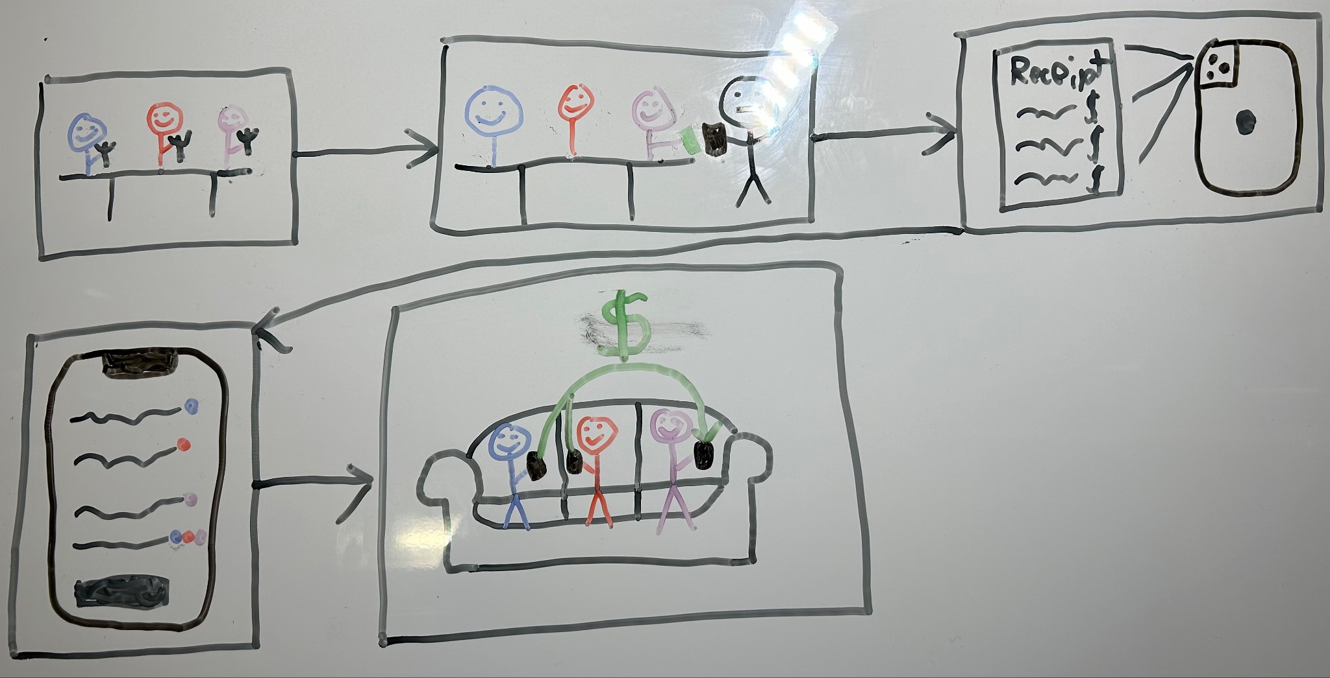
Ecological Sketch
Notes:
Will

Slide 6
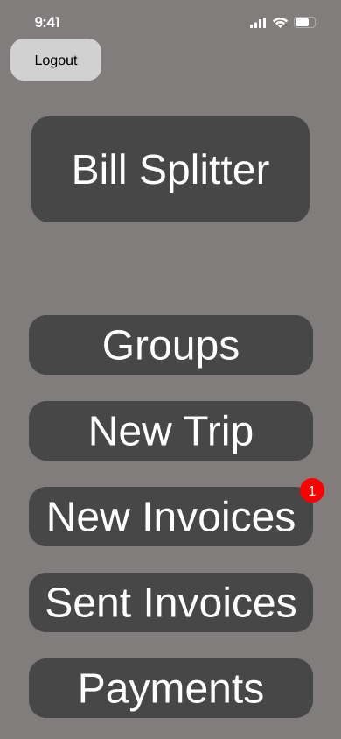
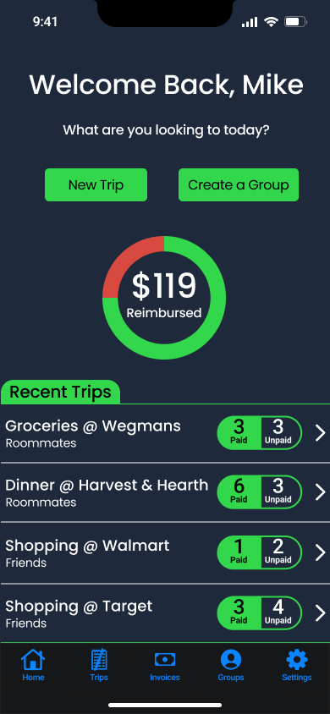
Medium-Fidelity and High-Fidelity Home Pages
Notes:
Ryan

Slide 7
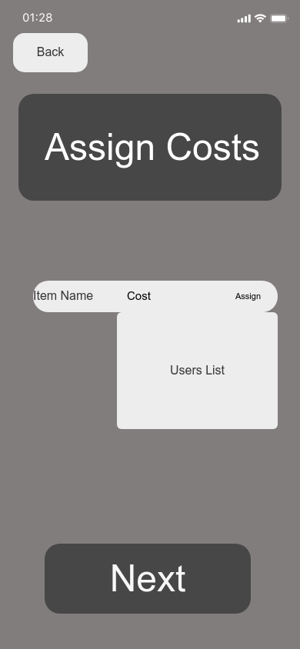
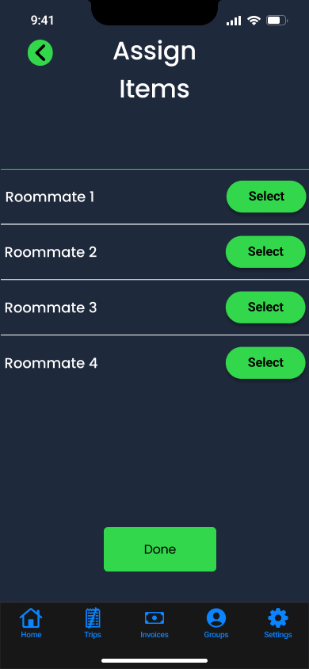
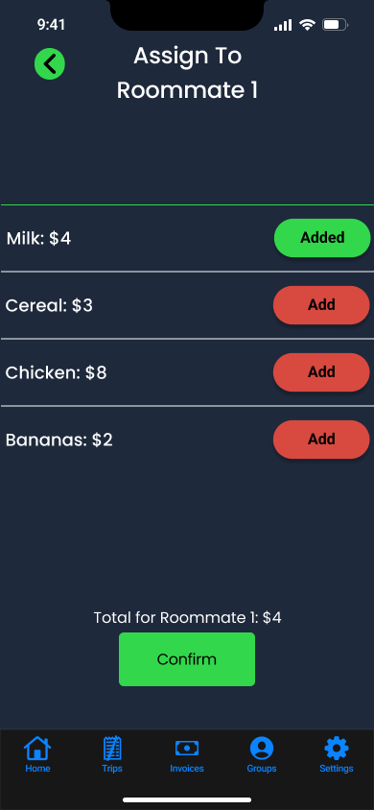
Medium-Fidelity and High-Fidelity Assign Items Pages
Notes:
Ryan

Slide 8

Demo
Group Formation
Scan Receipt
Manually Input Items
Assign Items
Pay Invoice
Notes:
Group Formation - Joe
Navigate to Groups Page
Add Group
Name Group
Select Group Type
Add Member
Search User
Add User
Scan Receipt — Will
Navigate to Trips Page
Add Trip
Select Group
Name Trip
Select “Scan Receipt”
Scan Receipt
Manually Input Items — Will
Navigate to Input Manually
Add Item(s)
Select “Next”
Assign Items to Users – Glenn
Navigate to Assign Items Page
Select User
Assign Items to User
Confirm
Repeat Previous Three Steps as Desired
Select Done
Select Confirm
Select Done
Pay Invoice — Ryan
Navigate to Invoices Page
Select an Invoice to Pay
Select Payment Type
Select Confirm
Select Done

Slide 9
Evaluation and Reporting

Slide 10
UX Target Table
User Role | UX Goal | UX Measure | Measuring Instrument | UX Metric | Baseline Level | Target Level | Observed Results | Meet Target?
Bill Payer | Pay an Existing Invoice | Learnability | Pay an Invoice | Number of Attempts | 2 | <3 | 1 | Yes
Bill Splitter | Add a Member to a Group | User Performance | Add a Group Member | Time spent on task | 30s | <15s | 32.25s | No
Bill Splitter | Create a Trip | Memorability | Create a (Second) Trip | Number of Users Encountering Unnecessary Screens | 75% | <50% | 0% | Yes
Any User | Use the App | Understandability | Use the App | Average Number of Non-Buttons Pressed | 1 | <1 | 0 | Yes
Notes:
Glenn

Slide 11
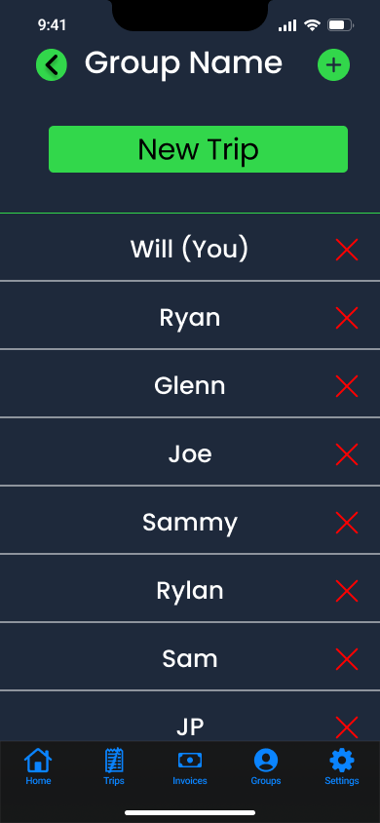
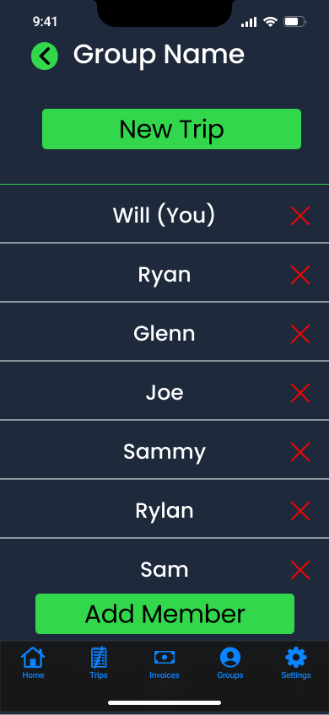
Old and New Group Member Pages
Notes:
Glenn

Slide 12
Reflection
Redesign of Systems
Use of Color
Menu Bar for User Control and Freedom
Development Tools
Notes:
Redesign of Systems — Glenn
Use of Color — Will
Menu Bar— Ryan
Development Tools — Joe Proto.io > Figma

